Slide 1

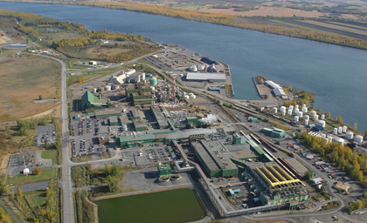

Fisher V500 helps CEZinc (Valleyfield, QC) Reduce Maintenance Costs.
CHALLENGE
The Hydrometallurgy plant has been using a Maisoneilan Camflex type valve with ceramic trim and SVI II smart positioner. The erosive nature of the manganese particles that are extracted during the leaching phase are damaging the seat ring causing unacceptable leakage rates and the valves are only lasting 6 months.
SOLUTION
A Fisher 1” Alloy 20 V500 with ceramic trim T4C in reverse flow with a Fisher 2052 actuator and Fieldvue DVC6200 smart positioner with Performance Diagnostics. During startup an Emerson technician was on site to assist the customer in proper installation, startup and to run initial diagnostics for future comparison.
RESULTS
After 3 months, signature scans revealed the V500 in “like new” condition. Same was found after 6 months of operation. The V500 robust construction design (stem size, stem/plug connection) improved reliability has allowed to reduce maintenance costs by $10k annually.
Customer testimonial if available
Notes:
The process is equipped with a bypass, therefore downtime is not an issue. This QBR can only be around reduction in maintenance costs. Will discuss with MP regarding quantifying the production savings.

